Slide 1
RATIO ANALYSIS

Slide 2
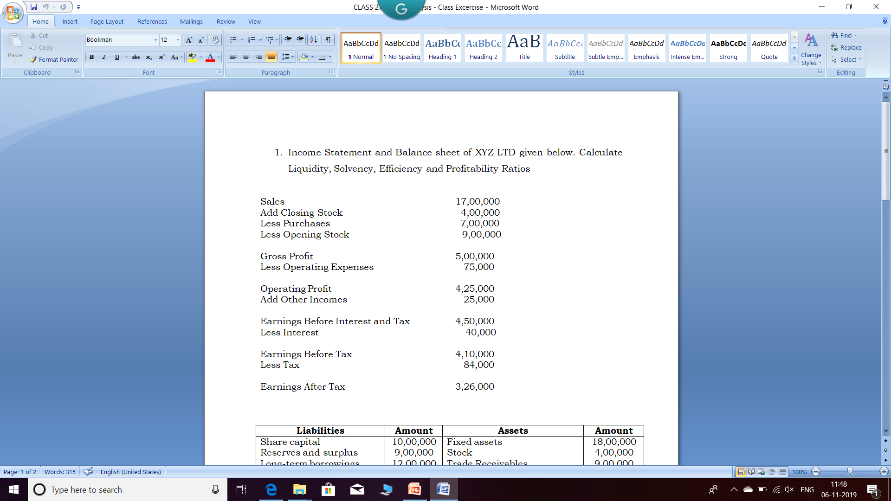

Slide 3
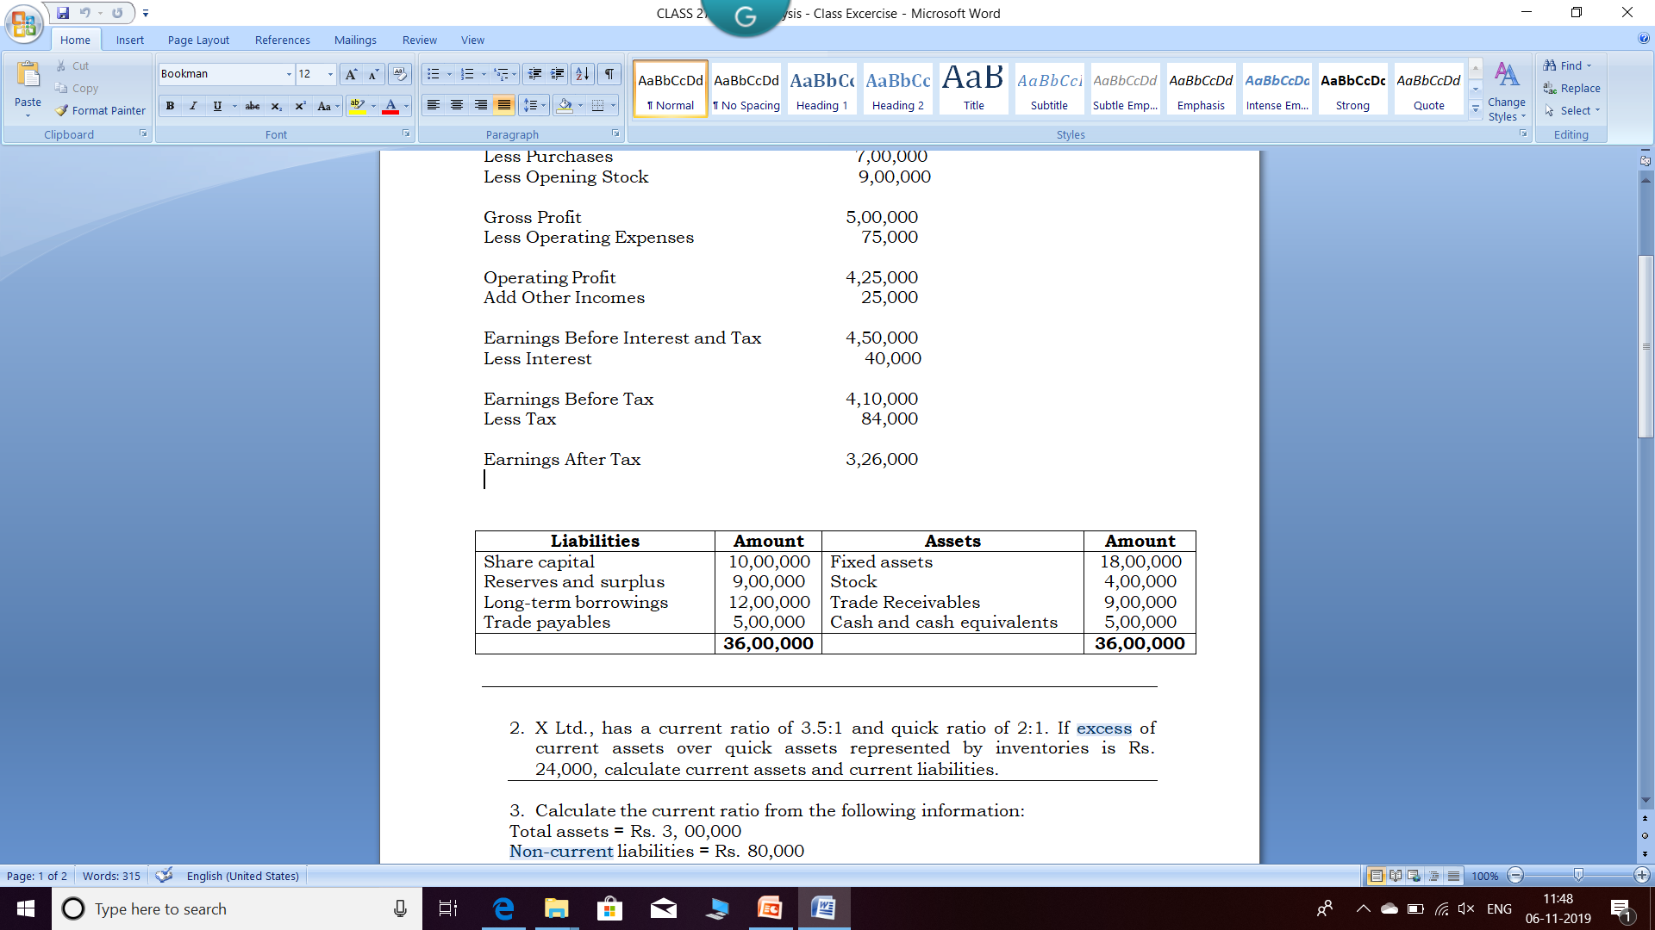
Working Notes
Owners Fund or Share Holders Equity = Share Capital + Reserve and Surplus
Long Term Borrowings means long term debt
Trade Payable means creditors or bills payable
Stock means inventories
Trade receivables means Debtors or bills receivables
Share Capital, Reserve and Surplus and Long term borrowings are considered as non current liabilities
Trade Payable considered as current liabilities
Fixed asset is non current assets
Stock, Trade Receivables and Cash and Cash equivalents considered as Current Assets

Slide 4
Reserves & surplus fund is created out of profits that are to be shared between the partners or share holders . Therefore fund created out of profit is a liability to the company. Reserves & Surplus fund is created to meet future contingencies. If the contingency does not arise as expected this fund can be distributed among partners.
In some cases it will treated as Current Liability

Slide 5
Current Ratio = Current Assets / Current Liabilities
= 18,00,000 / 5,00,000 = 3.6 : 1
Quick ratio = Quick Assets / Current Liabilities
= 14,00,000 / 5,00,000 = 2.8 : 1

Slide 6
Debt-Equity Ratio = Long Term Debt/Equity
= 12,00,000 / 19,00,000
= 0.63 : 1
Total assets to Debt Ratio = Total assets/Long-term debts
= 36,00,000 / 12,00,000
= 3:1

Slide 7
Inventory Turnover Ratio = Sales / Average Inventory
= 17,00,000 / (9,00,000+4,00,000)/2
= 2.61 times
Assets Turnover Ratio = Sales / Total Assets
= 17,00,000 / 36,00,000
= 0.47 times
Fixed Asset Turnover Ratio = Sales / Net Fixed Asset
= 17,00,000 / 18,00,000
= 0.94 times

Slide 8
Debtors Turnover Ratio = Credit Sales / Average Debtors
= 17,00,000 / 9,00,000
= 1.88 times
Creditors Turnover Ratio = Credit Purchases / Average Creditors
= 7,00,000 / 5,00,000
= 1.4 times
Working Capital Turnover Ratio = Sales / Working Capital
= 17,00,000 / (18,00,000-5,00,000)
= 1.30 times

Slide 9
Gross Profit Ratio = Gross Profit/Sales × 100
= 5,00,000 / 17,00,000 * 100
= 29.41%
Operating Profit Ratio = Operating Profit/ Sales × 100
= 4,25,000 / 17,00,000 * 100
= 25%
Net Profit Ratio = Net Profit / Sales * 100
= 3,26,000 / 17,00,000 * 100
= 19.17%
Return On Assets = Net Income/Total Assets * 100
= 3,26,000 / 36,00,000 * 100
= 9.05%
Return On Equity = Net Income / Shareholder’s Equity *100
= 3,26,000 / 19,00,000 * 100
= 17.15%

Slide 10
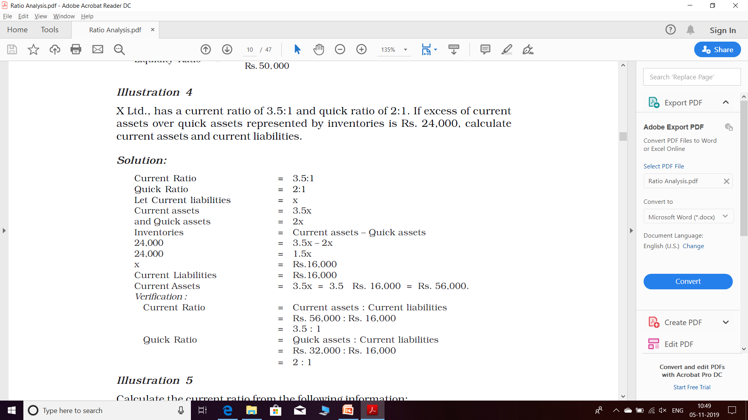

Slide 11
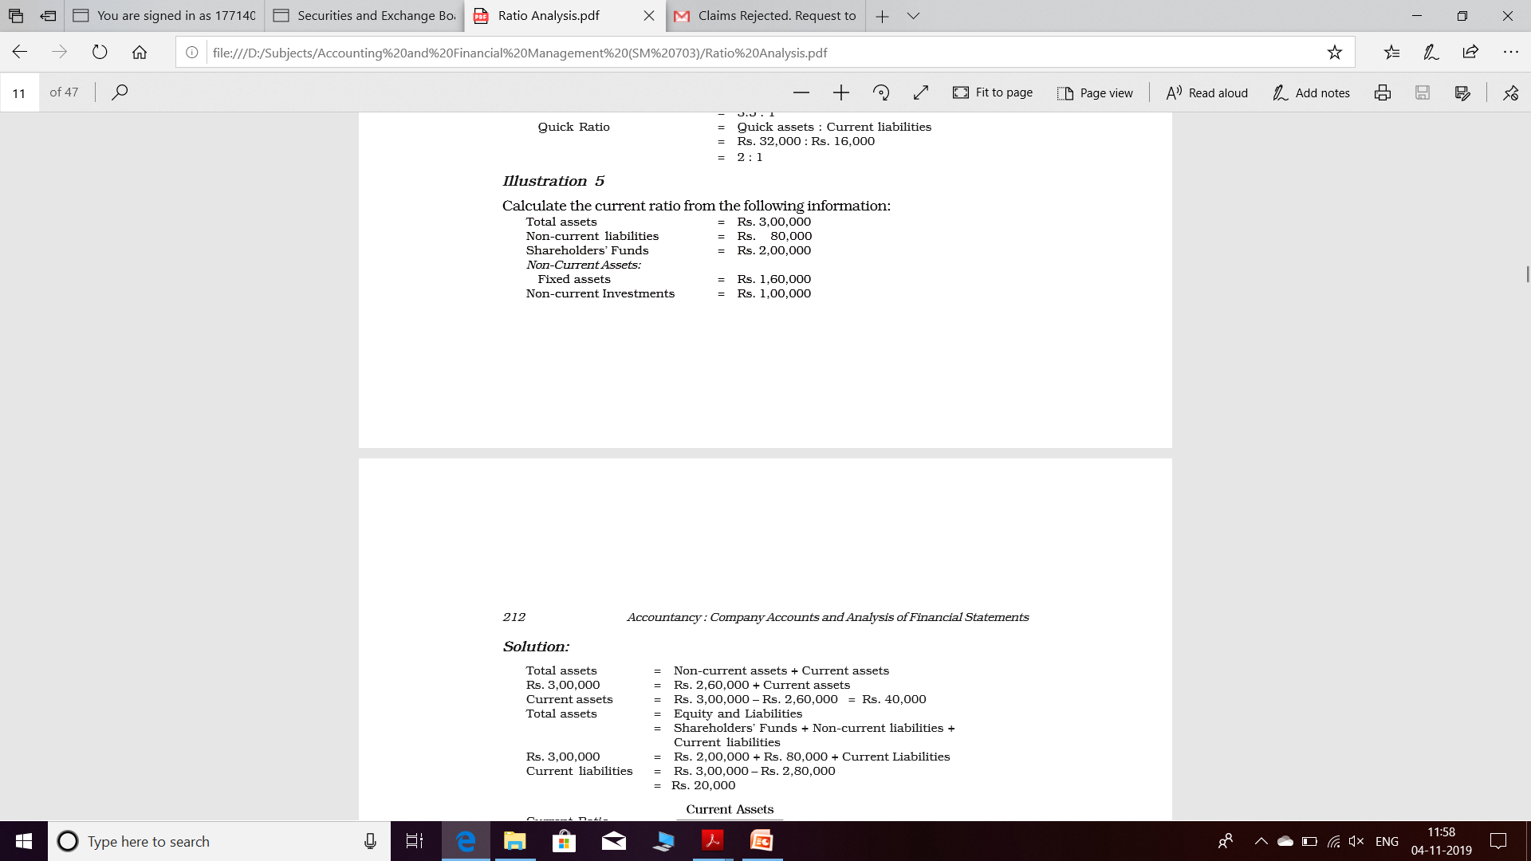

Slide 12
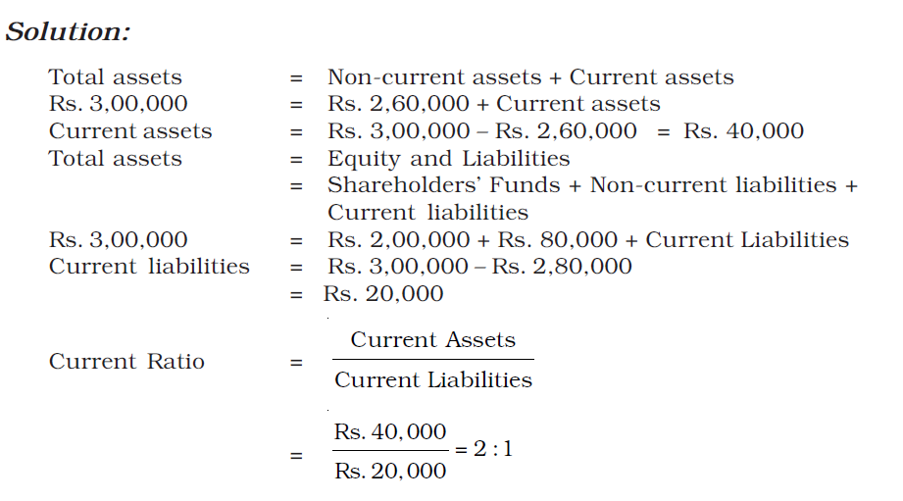

Slide 13
THANK YOU

